Slide 1
Econ 7900
Statistics for Data Science
Instructor: CAO Kang Hua 曹康華
Lecture 4
Statistical Inference: Significance Tests About Hypotheses

Slide 2
Scientific Method
The scientific method is an empirical method of acquiring knowledge that has characterized the development of science since at least the 17th century.
It involves careful observation, applying rigorous skepticism about what is observed, given that cognitive assumptions can distort how one interprets the observation.
It involves formulating hypotheses, via induction, based on such observations; experimental and measurement-based statistical testing of deductions drawn from the hypotheses; and refinement (or elimination) of the hypotheses based on the experimental findings.
Notes:
2
Source: Wikipedia

Slide 3
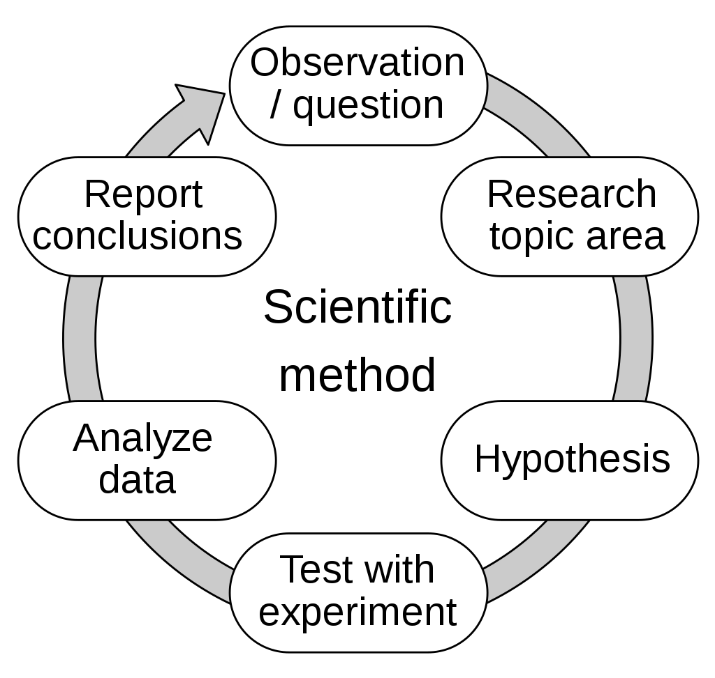
Scientific Method
Notes:
3
Source: Wikipedia

Slide 4
Hypothesis
The main goal of many research studies is to check whether the data support certain statements or predictions. These statements are hypotheses about a population. They are usually expressed in terms of population parameters for variables measured in the study.
In statistics, a hypothesis is a statement about a population, usually claiming that a population parameter takes a particular numerical range of values.
Notes:
4

Slide 5
The Steps of a Significance Test
A significance test is a method of using data to summarize the evidence about a hypothesis.
A significance test about a hypothesis has five steps.
  Assumptions
  Hypotheses
  Test Statistic
  P-value
  Conclusion
Notes:
5

Slide 6
Step 1: Assumptions
A significance test assumes that the data production used randomization.
Other assumptions may include:
  Assumptions about the sample size.
  Assumptions about the shape of the population
  distribution.
Notes:
6

Slide 7
Step 2: Hypothesis
Each significance test has two hypotheses:
  The null hypothesis is a statement that the parameter takes a particular value. It has a single parameter value.
  The alternative hypothesis states that the parameter falls in some alternative range of values.
Notes:
7

Slide 8
Null and Alternative Hypotheses
The value in the null hypothesis usually represents no effect.
The symbol H₀ denotes the null hypothesis.
The value in the alternative hypothesis usually represents an effect of some type.
  The symbol H_{a} denotes the alternative hypothesis.
  The alternative hypothesis should express what the researcher hopes to show. The hypotheses should be formulated before viewing or analyzing the data!
Notes:
8

Slide 9
Step 3: Test Statistic
A test statistic describes how far the point estimate falls from the parameter value given in the null hypothesis. Usually, this distance is measured by the number of standard errors between the point estimate and the parameter.
Notes:
9

Slide 10
Step 4: P-value
To interpret a test statistic value, we use a probability summary of the evidence against the null hypothesis, H₀.
  First, we presume that H₀ is true.
  Then we consider the sorts of values we’d expect to get for the test statistic, according to its sampling distribution presuming H₀ is true.
Notes:
10

Slide 11
Step 4: P-value
We summarize how far out in the tail the test statistic falls by the tail probability of that value and values even more extreme.
  This probability is called a P-value.
  The smaller the P-value, the stronger the
  evidence is against H₀.
Notes:
11

Slide 12
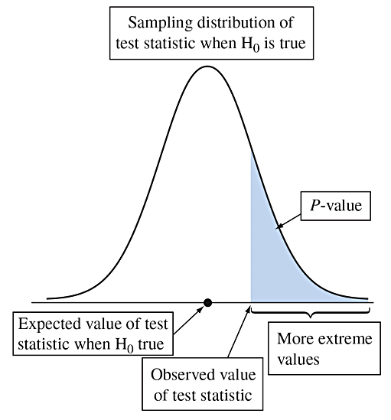
Step 4: P-value
Figure 9.1 Suppose H₀ Were True. The P-value Is the Probability of a Test Statistic Value Like the Observed One or Even More Extreme. This is the shaded area in the tail of the sampling distribution. Question Which gives stronger evidence against the null hypothesis, a P-value of 0.20 or of 0.01? Why?
Notes:
12

Slide 13
Step 4: P-value
The P-value is the probability that the test statistic equals the observed value or a value even more extreme.
It is calculated by presuming that the null hypothesis is true.
The smaller the P-value, the stronger the evidence the data provide against the null hypothesis. That is, a small P-value indicates a small likelihood of observing the sampled results if the null hypothesis were true.
Notes:
13

Slide 14
Step 5: Conclusion
The conclusion of a significance test reports the P-value and interprets what it says about the question that motivated the test.
Sometimes this includes a decision about the validity of the null hypothesis H₀.
Notes:
14

Slide 15
Example: Are Astrologers’ Predictions Better Than Guessing?
An astrologer prepares horoscopes for 116 adult volunteers. Each subject also filled out a California Personality Index (CPI) survey. For a given adult, his or her horoscope is shown to the astrologer along with their CPI survey as well as the CPI surveys for two other randomly selected adults. The astrologer is asked which survey is the correct one for that adult.
  With random guessing, p = 1/3
  The astrologers’ claim: p > 1/3
  The hypotheses for this test:
Notes:
15

Slide 16
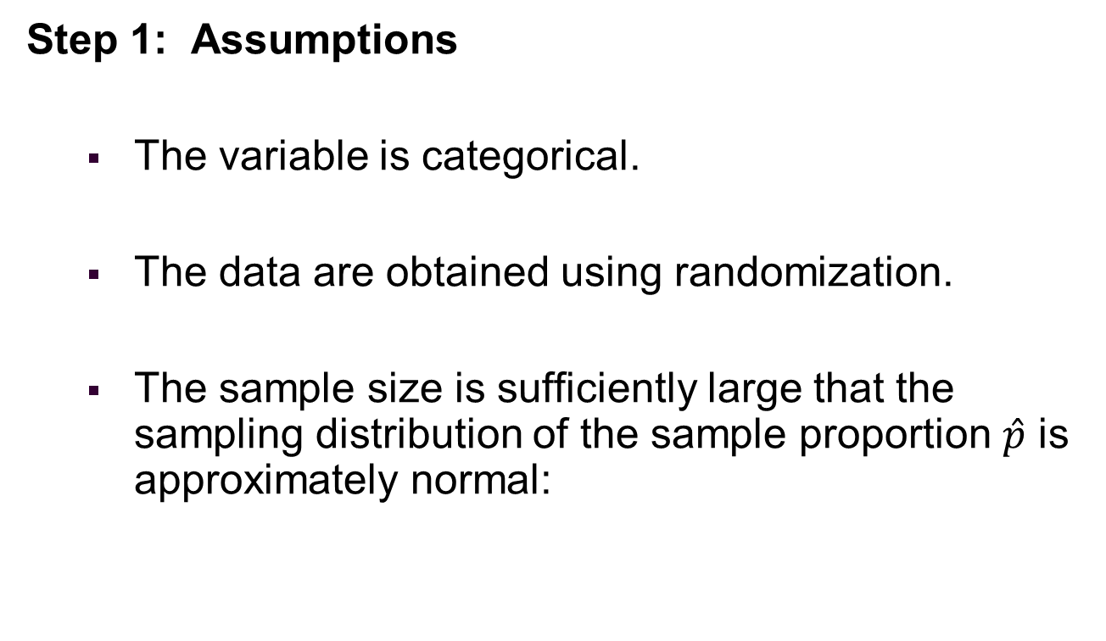
Steps of a Significance Test about a Population Proportion
Notes:
16

Slide 17
Steps of a Significance Test about a Population Proportion
Step 2: Hypotheses
The null hypothesis has the form:
The alternative hypothesis has the form:
Notes:
17

Slide 18
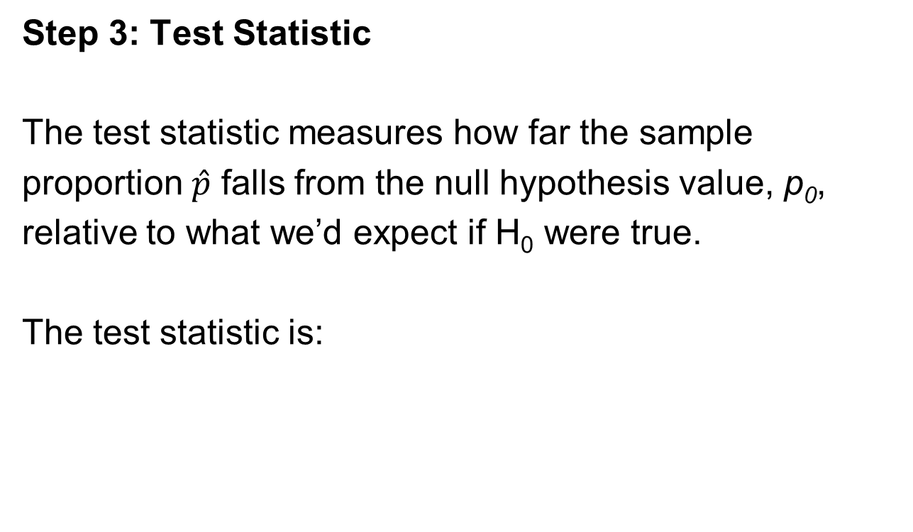
Steps of a Significance Test about a Population Proportion
Notes:
18

Slide 19
Steps of a Significance Test about a Population Proportion
Step 4: P-value
The P-value summarizes the evidence.
It describes how unusual the observed data would
be if H₀ were true.
Notes:
19

Slide 20
Steps of a Significance Test about a Population Proportion
Step 5: Conclusion
We summarize the test by reporting and interpreting the P-value.
Notes:
20

Slide 21
Example: Are Astrologers’ Predictions Better Than Guessing?
Step 1: Assumptions
  The data is categorical – each prediction falls in the category “correct” or “incorrect”.
  Each subject was identified by a random number. Subjects were randomly selected for each experiment.
Notes:
21

Slide 22
Example: Are Astrologers’ Predictions Better Than Guessing?
Step 2: Hypotheses
The null hypothesis has the form
  The alternative hypothesis has the form
Notes:
22

Slide 23
Example: Are Astrologers’ Predictions Better Than Guessing?
Step 3: Test Statistic:
  In the actual experiment, the astrologers were correct with 40 of their 116 predictions (a success rate of 0.345).
Notes:
23

Slide 24
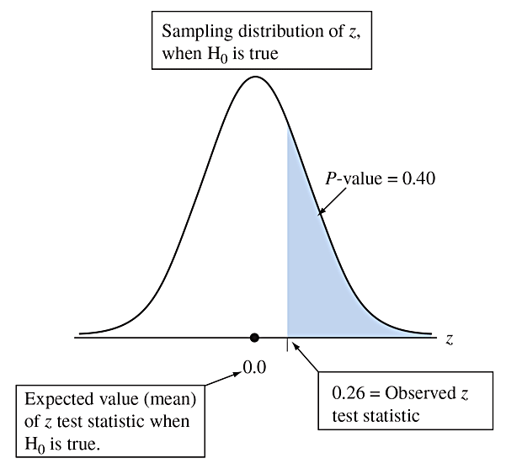
Example: Are Astrologers’ Predictions Better Than Guessing?
Step 4: P-value
The P-value of 0.40 tells us that if H₀ were true, the probability would be 0.40 that the test statistic would be as or more extreme than the observed value.
Figure 9.2 Calculation of P-value, When z = 0.26 for Testing H₀: p = 1/3 Against
H_{a}: p > 1/3. Presuming that H₀ is true, the P-value is the right-tail probability of a test statistic value even more extreme than observed. Question Logically, why are the right-tail z -scores considered the more extreme values for testing H₀ against H_{a} :p > 1/3?
Notes:
24

Slide 25
Example: Are Astrologers’ Predictions Better Than Guessing?
Step 5: Conclusion
The P-value of 0.40 is not especially small.
It does not provide strong evidence against H₀: p = 1/3.
We would not conclude that astrologers have
special predictive powers.
Notes:
25

Slide 26
Interpreting the P-value
A significance test analyzes the strength of the evidence against the null hypothesis H₀.
We start by presuming that H₀ is true.
The burden of proof is on H_{a}.
Notes:
26

Slide 27
Interpreting the P-value
The approach used in hypothesis testing is called a proof by contradiction.
To convince ourselves that H_{a} is true, we must show that data contradict H₀.
If the P-value is small, the data contradict H₀ and support H_{a}.
Notes:
27

Slide 28
Two-Sided Significance Tests
A two-sided alternative hypothesis has the form
The P-value is the two-tail probability under the standard normal curve.
We calculate this by finding the tail probability in a single tail and then doubling it.
Notes:
28

Slide 29
Example: Dogs Detecting Cancer by Smell
Study:
Investigate whether dogs can be trained to distinguish a patient with bladder cancer by smelling compounds released in the patient’s urine.
  Experiment:
  Each of 6 dogs was tested with 9 trials.
  In each trial, one urine sample from a bladder cancer patient was randomly place among 6 control urine samples.
Notes:
29

Slide 30
Example: Dogs Detecting Cancer by Smell
Results:
In a total of 54 trials with the six dogs, the dogs made the correct selection 22 times (a success rate of 0.407).
Question to Explore:
Does this study provide strong evidence that the dogs’ predictions were better or worse than with random guessing?
Notes:
30

Slide 31
Example: Dogs Detecting Cancer by Smell
Step 1: Check the sample size requirement:
Is the sample size sufficiently large to use the hypothesis test for a population proportion?
np₀ is not large enough.
We will see that the two-sided test is robust even when this assumption is not satisfied.
Notes:
31

Slide 32
Example: Dogs Detecting Cancer by Smell
Step 2: Hypotheses
Step 3: Test Statistic
Notes:
32

Slide 33
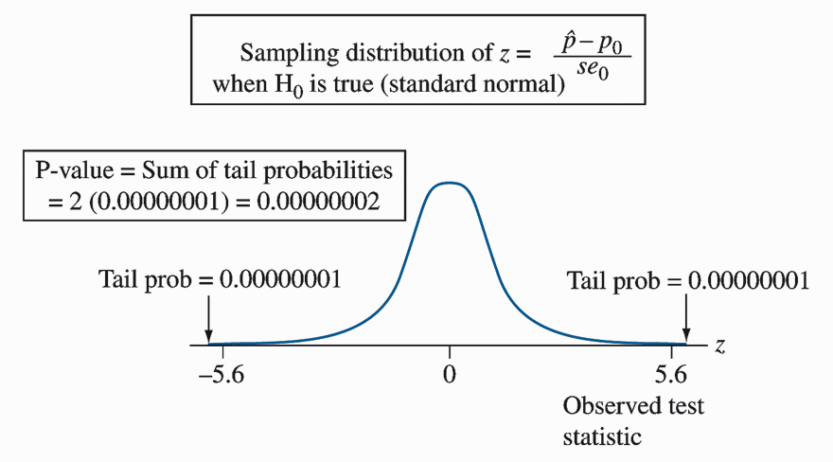
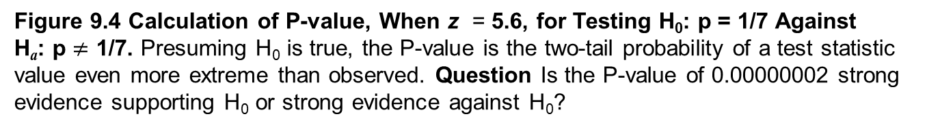
Example: Dogs Detecting Cancer by Smell
Step 4: P-value
Notes:
33

Slide 34
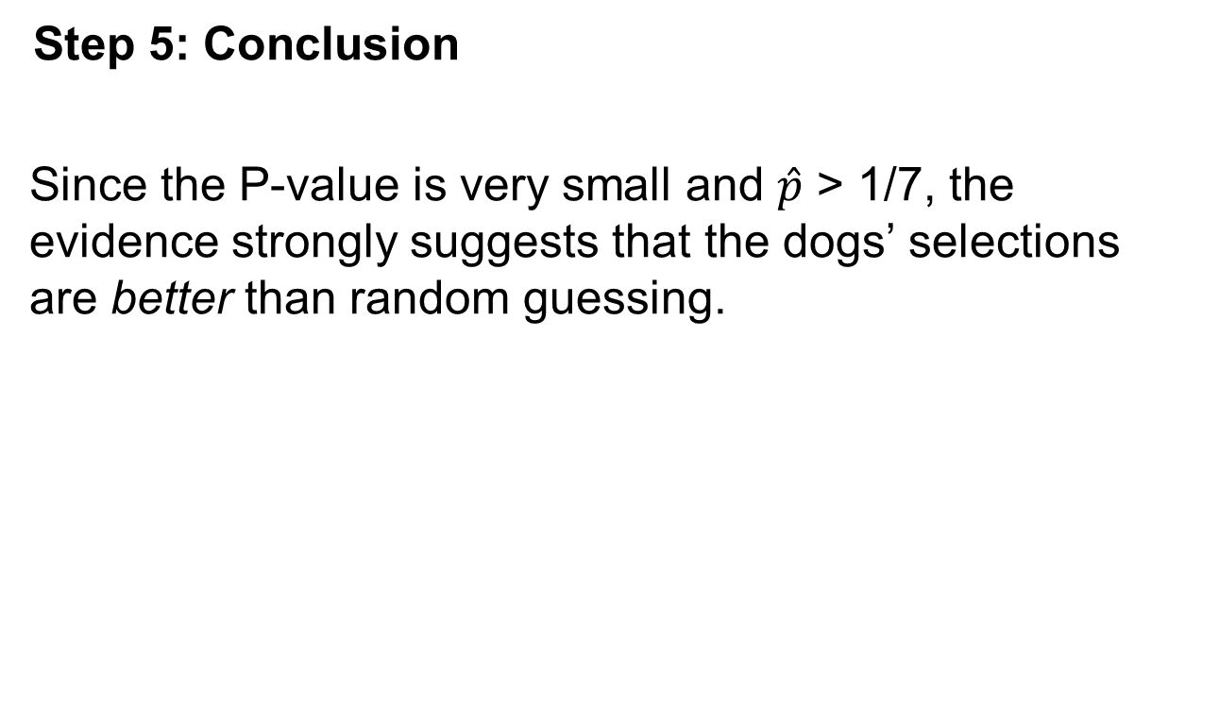
Example: Dogs Detecting Cancer by Smell
Notes:
34

Slide 35
Example: Dogs Detecting Cancer by Smell
Insight:
  In this study, the subjects were a convenience sample rather than a random sample from some population.
  Also, the dogs were not randomly selected.
  Any inferential predictions are tentative. They are valid only to the extent that the patients and the dogs are representative of their populations.
  The predictions become more conclusive if similar results occur in other studies.
Notes:
35

Slide 36
Summary: P-values for Different Alternative Hypotheses
Alternative Hypothesis
P-value
Right-tail probability
Left-tail probability
Two-tail probability
Notes:
36

Slide 37
The Significance Level Tells Us How Strong the Evidence Must Be
Sometimes we need to make a decision about whether the data provide sufficient evidence to reject H₀.
Before seeing the data, we decide how small the P-value would need to be to reject H₀.
This cutoff point is called the significance level.
Notes:
37

Slide 38
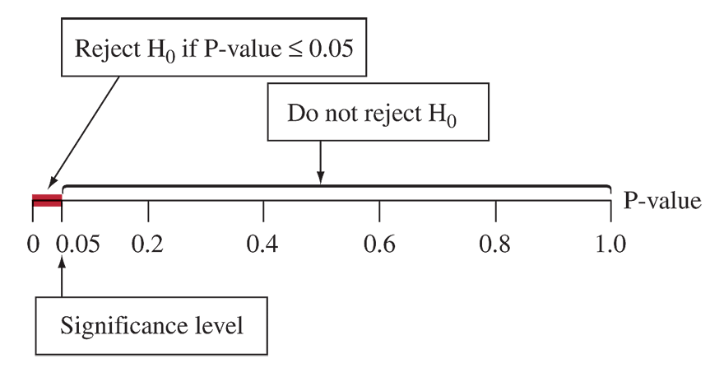
The Significance Level Tells Us How Strong the Evidence Must Be
Figure 9.5 The Decision in a Significance Test. Reject H₀ if the P-value is less than or
equal to a chosen significance level, usually 0.05.
Notes:
38

Slide 39
Significance Level
The significance level is a number such that we reject H₀ if the P-value is less than or equal to that number.
In practice, the most common significance level is 0.05.
When we reject H₀, we say the results are statistically significant.
Notes:
39

Slide 40
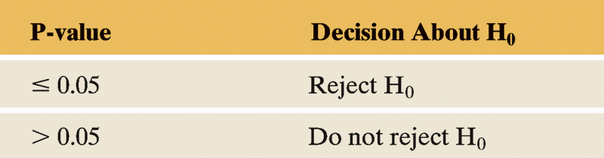
Possible Decisions in a Test of Significance
Table 9.1 Possible Decisions in a Test of Significance.
Notes:
40

Slide 41
Report the P-value
Learning the actual P-value is more informative than learning only whether the test is “statistically significant at the 0.05 level.”
The P-values of 0.001 and 0.049 are both statistically significant in this sense, but the first P-value provides much stronger evidence that the result is statistically significant than the second P-value.
Notes:
41

Slide 42
“Do Not Reject H₀” Is Not the Same as Saying “Accept H₀”
Analogy: Courtroom trial
  Null Hypothesis: Defendant is innocent.
  Alternative Hypothesis: Defendant is guilty.
  If the jury acquits the defendant, this does not mean that it accepts the defendant’s claim of innocence.
  Innocence is plausible because guilt has not been established beyond a reasonable doubt.
Notes:
42

Slide 43
Deciding between a One-Sided and a Two-Sided Test?
Things to consider in deciding on the alternative hypothesis:
  The context of the real problem.
  In most research articles, significance tests use two-sided P-values.
  Confidence intervals are two-sided.
Notes:
43

Slide 44
The Binomial Test for Small Samples
Notes:
44

Slide 45
Steps of a Significance Test About a Population Mean
Step 1: Assumptions
  The variable is quantitative.
  The data production employed randomization.
  The population distribution is approximately normal. This is most crucial when n is small and is H_{a} one-sided.
Notes:
45

Slide 46
Steps of a Significance Test About a Population Mean
Step 2: Hypotheses:
The null hypothesis has the form:
The alternative hypothesis has the form:
Notes:
46

Slide 47
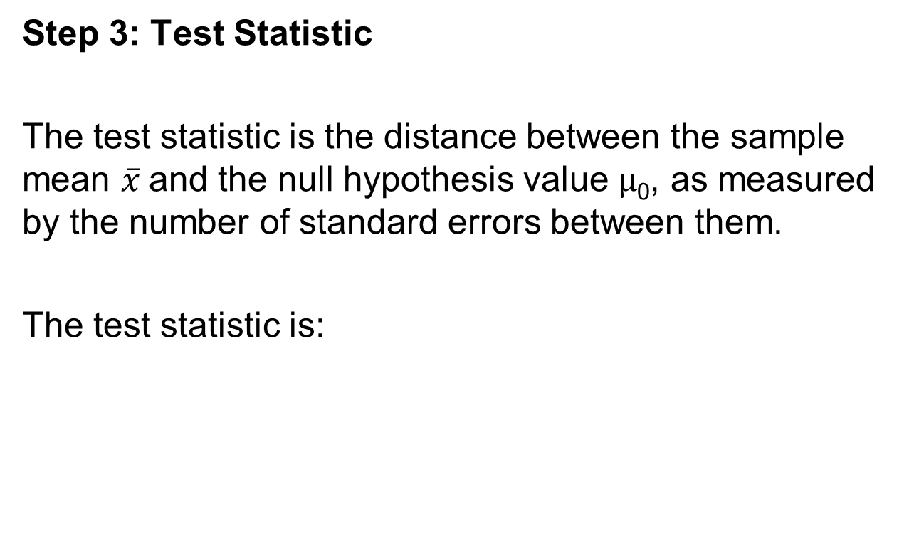
Steps of a Significance Test About a Population Mean
Notes:
47

Slide 48
Steps of a Significance Test About a Population Mean
Step 3: Test Statistic
When H₀ is true, the t test statistic has approximately the t distribution. The t distribution is specified by its degrees of freedom, which equal n – 1 for inference about a mean. This test statistic is called a t statistic.
Notes:
48

Slide 49
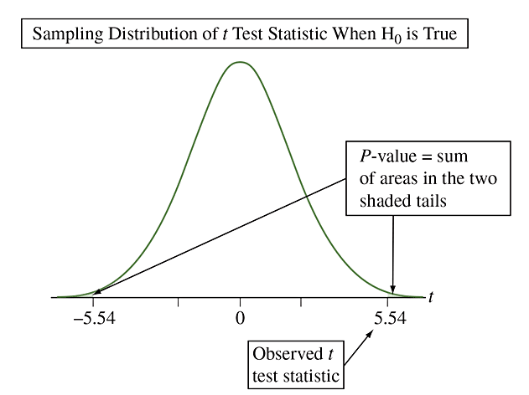
Steps of a Significance Test About a Population Mean
Step 3: Test Statistic
Figure 9.6 The t Distribution of the t Test Statistic. The t distribution looks like the
standard normal but has more variability, i.e., fatter tails. There is stronger evidence against
H₀ when the t test statistic falls farther out in a tail. The P-value for a two-sided H_{a} is a two-tail
probability (shaded in figure). Question Why is it that t-scores farther out in the tails provide
stronger evidence against H₀?
Notes:
49

Slide 50
Steps of a Significance Test About a Population Mean
Step 4: P-value
  The P-value summarizes the evidence.
  It describes how unusual the data would be if H₀ were true.
Notes:
50

Slide 51
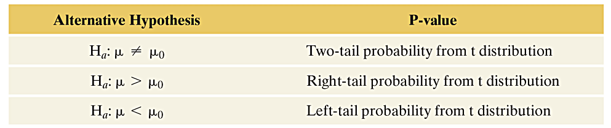
Summary of P-values for Different Alternative Hypotheses
The P-value is a single tail or a two-tail probability depending on whether the alternative hypothesis is one-sided or two-sided.
Notes:
51

Slide 52
Steps of a Significance Test About a Population Mean
Step 5: Conclusion
The conclusion of a significance test reports the P-value and interprets what it says about the question that motivated the test.
Notes:
52

Slide 53
Example: Mean Weight Change in Anorexic Girls
A study compared different psychological therapies for teenage girls suffering from anorexia.
The variable of interest was each girl’s weight change: weight at the end of the study minus weight at the beginning of the study.
The weight change was positive if the girl gained weight and negative if she lost weight.
Notes:
53

Slide 54
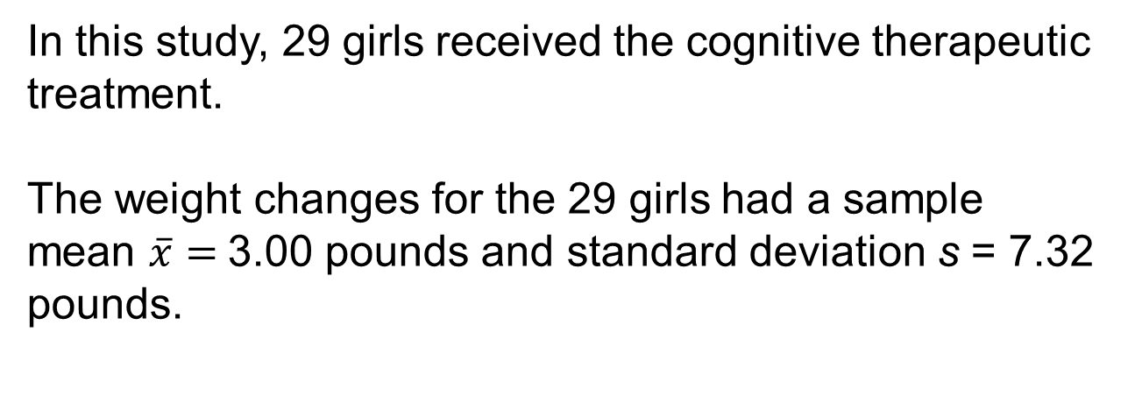
Example: Mean Weight Change in Anorexic Girls
Notes:
54

Slide 55
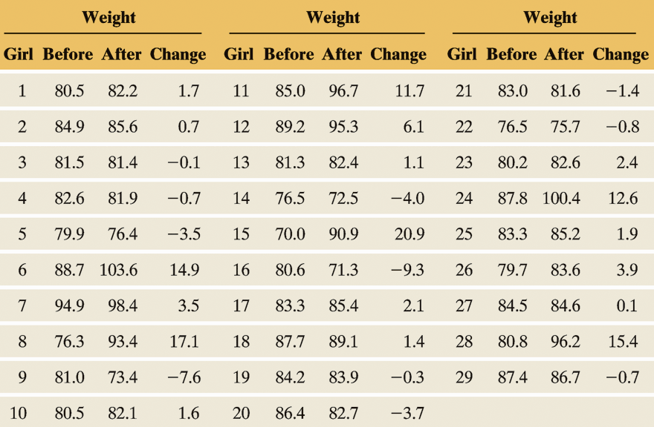
Example: Mean Weight Change in Anorexic Girls
Table 9.4 Weights of Anorexic Girls (in Pounds) Before and After Treatment
This example uses the weight change as the variable of interest.
Notes:
55

Slide 56
Example: Mean Weight Change in Anorexic Girls
How can we frame this investigation in the context of a significance test that can detect whether the therapy was effective?
Null hypothesis: “no effect”
Alternative hypothesis: therapy is “effective”
Notes:
56

Slide 57
Example: Mean Weight Change in Anorexic Girls
Step 1: Assumptions
The variable (weight change) is quantitative.
The subjects were a convenience sample, rather than a random sample. The question is whether these girls are a good representation of all girls with anorexia.
The population distribution is approximately normal.
Notes:
57

Slide 58
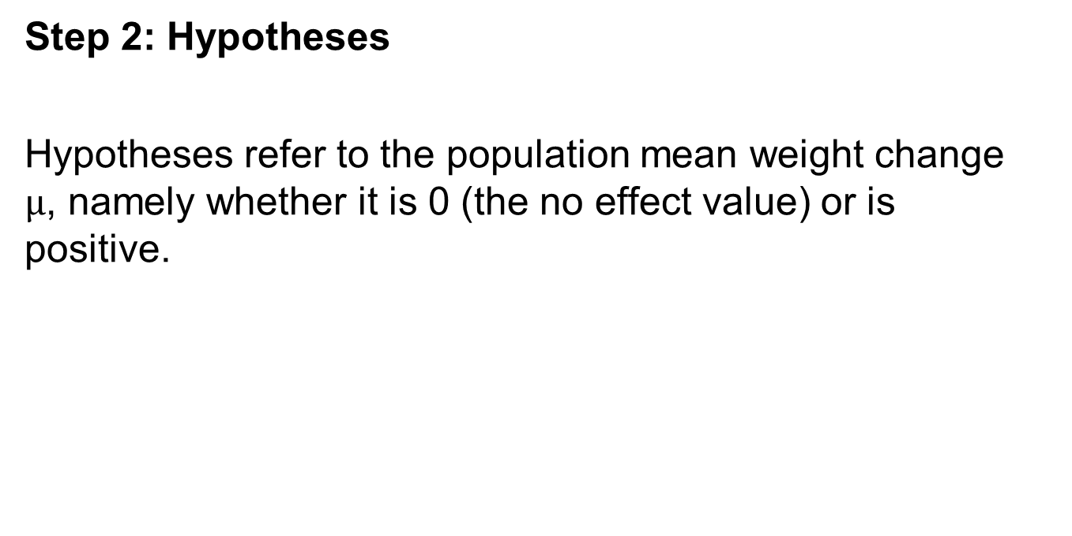
Example: Mean Weight Change in Anorexic Girls
Notes:
58

Slide 59
Example: Mean Weight Change in Anorexic Girls
Step 3: Test Statistic
Notes:
59

Slide 60
Example: Mean Weight Change in Anorexic Girls
Step 4: P-value
  The P-value is the area to the right of t = 2.21 for the t distribution with 28 df. This value is 0.018.
  If the treatment had no effect, the probability of obtaining a sample this extreme would be 0.018.
Notes:
60

Slide 61
Example: Mean Weight Change in Anorexic Girls
Step 5: Conclusion
  The small P-value of 0.018 provides considerable evidence against the null hypothesis (the hypothesis that the therapy had no effect).
Notes:
61

Slide 62
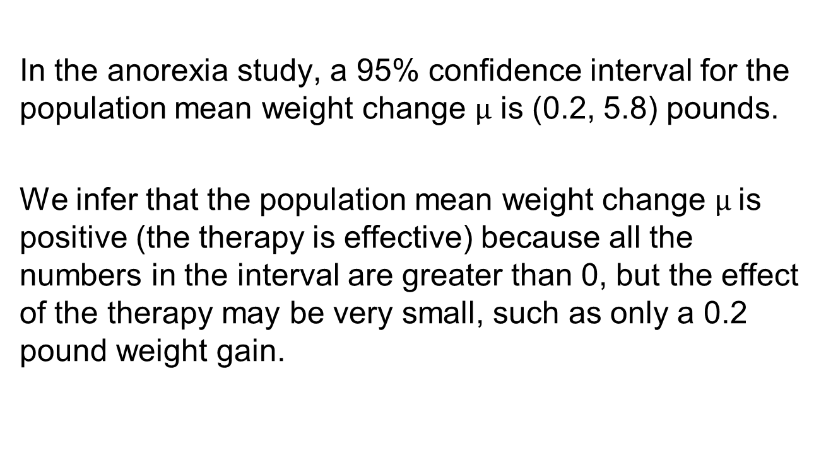
Results of two-sided tests and confidence intervals agree
Notes:
62

Slide 63
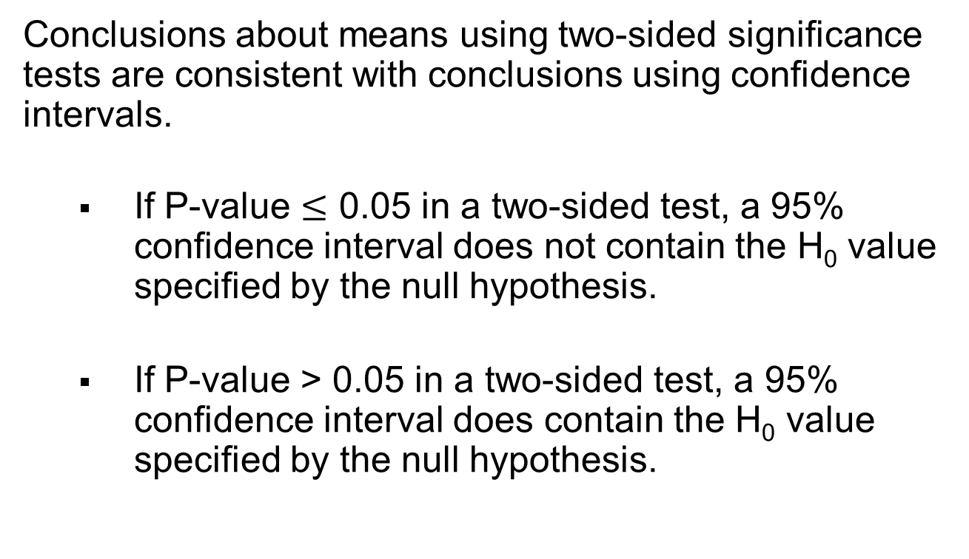
Results of Two-Sided Tests and Results of Confidence Intervals Agree
Notes:
63

Slide 64
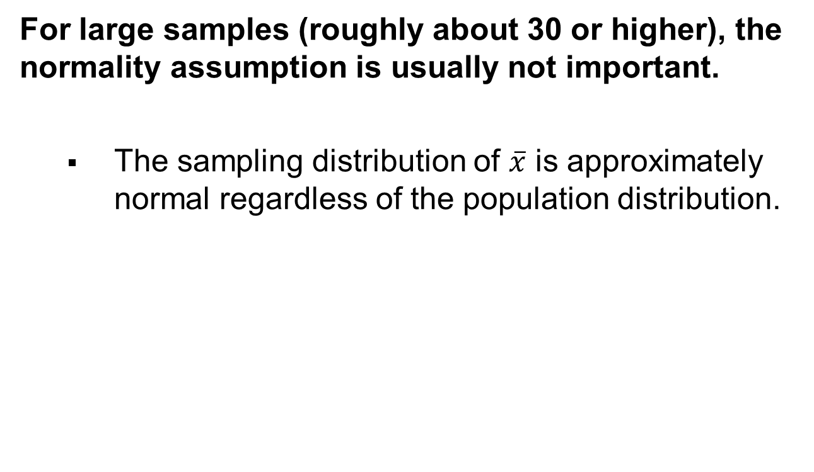
When the Population Does Not Satisfy the Normality Assumption
Notes:
64

Slide 65
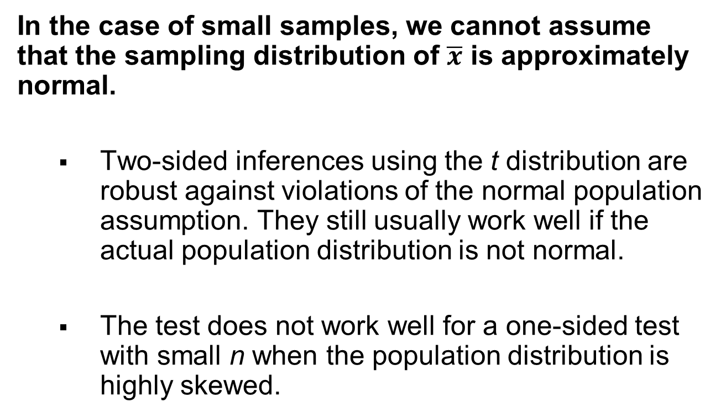
When the Population Does Not Satisfy the Normality Assumption
Notes:
65

Slide 66
Regardless of Robustness, Look at the Data
Whether n is small or large, you should look at the data to check for severe skew or for outliers that occur primarily in one direction.
  They could cause the sample mean to be a misleading measure.
Notes:
66

Slide 67
Type I and Type II Errors
When H₀ is true, a Type I Error occurs when H₀ is rejected. (a false positive)
When H₀ is false, a Type II Error occurs when H₀ is not rejected. (a false negative)
As P(Type I Error) goes Down, P(Type II Error) goes Up.
The two probabilities are inversely related.
Notes:
67

Slide 68
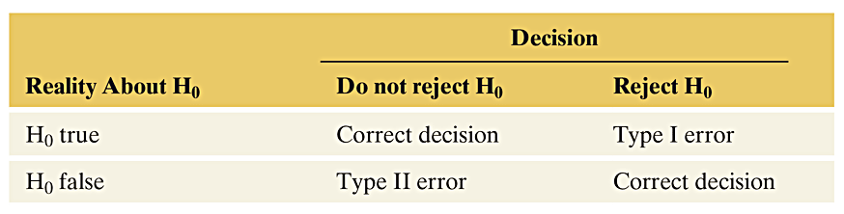
Significance Test Results
Table 9.5 The Four Possible Results of a Decision in a Significance Test. Type I and Type II errors are the two possible incorrect decisions. We make a correct decision if we do not reject H₀ when it is true or if we reject it when it is false.
Notes:
68

Slide 69
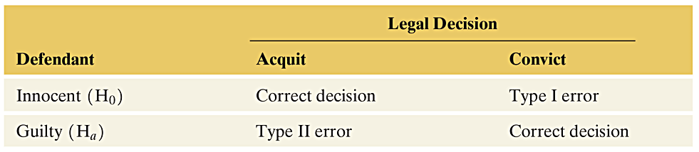
Significance Test Results
Table 9.6 Possible Results of a Legal Trial
Notes:
69

Slide 70

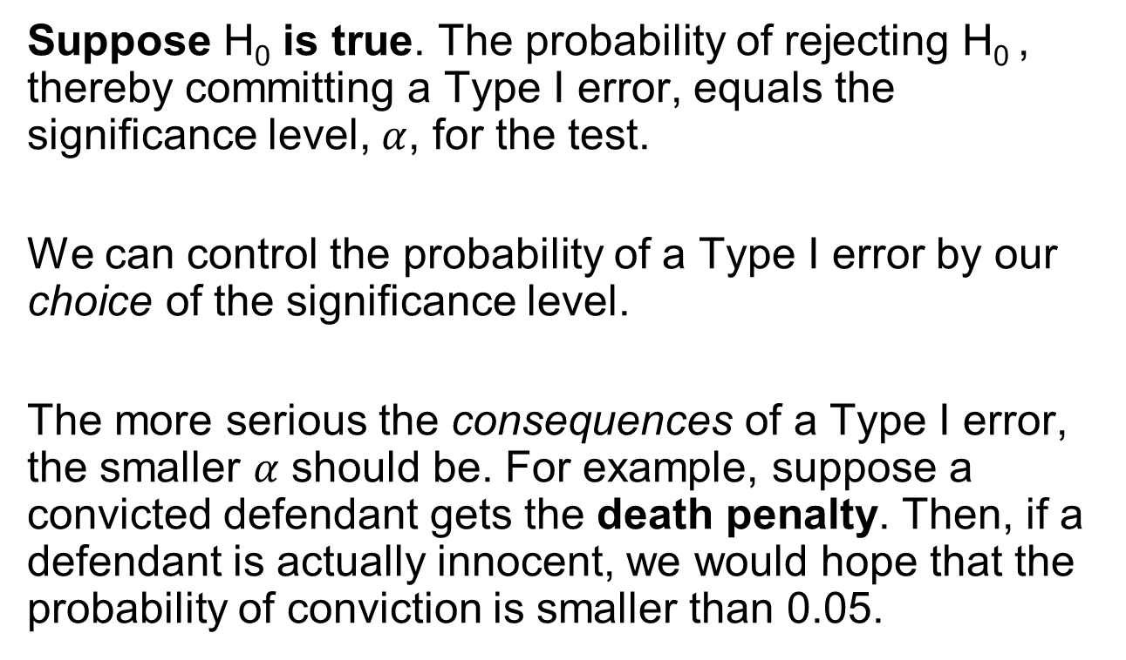
Notes:
70

Slide 71
Statistical Significance Does Not Mean Practical Significance
When we conduct a significance test, its main relevance is studying whether the true parameter value is:
    1. Above, or below, the value in H₀ and
    2. Sufficiently different from the value in H₀ to be
    of practical importance.
Notes:
71

Slide 72
What the Significance Test Tells Us
A significance test gives us information about whether the parameter differs from the H₀ value and its direction from that value.
It does not tell us about the practical significance (or importance) of the finding.
Statistical significance is not the same thing as practical significance.
Notes:
72

Slide 73
Statistical Significance vs. Practical Significance
A small P-value, such as 0.001, is highly statistically significant, but it does not imply an important finding in any practical sense.
In particular, whenever the sample size is large, small P-values can occur when the point estimate is near the parameter value in H₀.
Notes:
73

Slide 74
Significance Tests Are Less Useful Than Confidence Intervals
Although significance tests are useful, most statisticians believe that this method has been overemphasized in research.
  A significance test merely indicates whether the particular parameter value in H₀ is plausible.
When a P-value is small, the significance test indicates that the hypothesized value is not plausible, but it tells us little about which potential parameter values are plausible.
  A Confidence Interval is more informative because it displays the entire set of believable values.
Notes:
74

Slide 75
Misinterpretations of Results of Significance Tests
Results of significance tests are often misinterpreted. Here are some important comments about significance tests, some of which we’ve already discussed:
“Do Not Reject H₀” does not mean “Accept H₀”. A P-value above 0.05 when the significance level is 0.05, does not mean that H₀ is correct. A test merely indicates whether a particular parameter value is plausible.
A confidence interval shows that there is a range of plausible values, not just a single one.
Notes:
75

Slide 76
Misinterpretations of Results of Significance Tests
Statistical significance does not mean practical significance. A small P-value does not tell us whether the parameter value differs by much in practical terms from the value in H₀.
The P-value cannot be interpreted as the probability that H₀ is true. The P-value is P(test statistic takes observed value or beyond in tails | H₀ true), NOT
P(H₀ true | observed test statistic value).
Notes:
76

Slide 77
Misinterpretations of Results of Significance Tests
It is misleading to report results only if they are “statistically significant”.
Some tests may be statistically significant just by
chance.
True effects may not be as large as initial estimates reported by the media.
Notes:
77

Slide 78
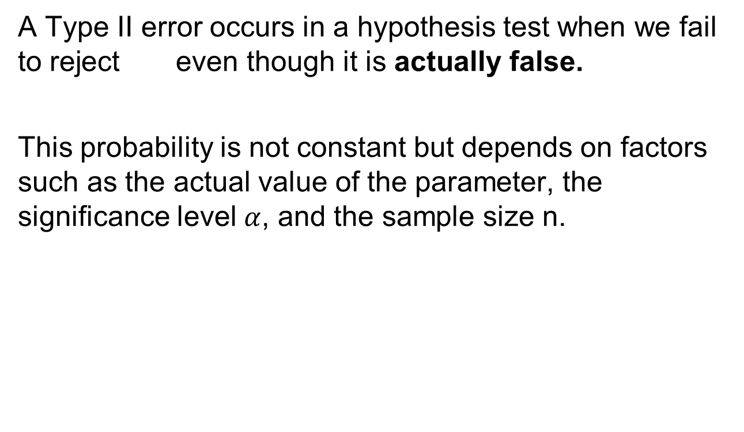
Type II Error
Notes:
78

Slide 79
Example: Part of a Study Design
Scientific “test of astrologers’ predictions”:
  For each of 116 adult volunteers, an astrologer prepared a horoscope based on the positions of the planets and the moon at the moment of the person’s birth.
  Each adult subject also filled out a California Personality Index (CPI) Survey.
Notes:
79

Slide 80
Example: Part of a Study Design
For a given adult, his or her birth data and horoscope were shown to the astrologer together with the results of the personality survey for that adult and for two other adults randomly selected from the group.
The astrologer was asked which personality chart of the 3 subjects was the correct one for that adult, based on his or her horoscope.
Notes:
80

Slide 81
Example: Part of a Study Design
28 astrologers were randomly chosen to take part in the experiment.
The National Council for Geocosmic Research claimed that the probability of a correct guess on any given trial in the experiment was larger than 1/3, the value for random guessing.
Notes:
81

Slide 82
Example: Part of a Study Design
With random guessing,
The astrologers’ claim:
The hypotheses for this test:
The significance level used for the test is 0.05.
Notes:
82

Slide 83
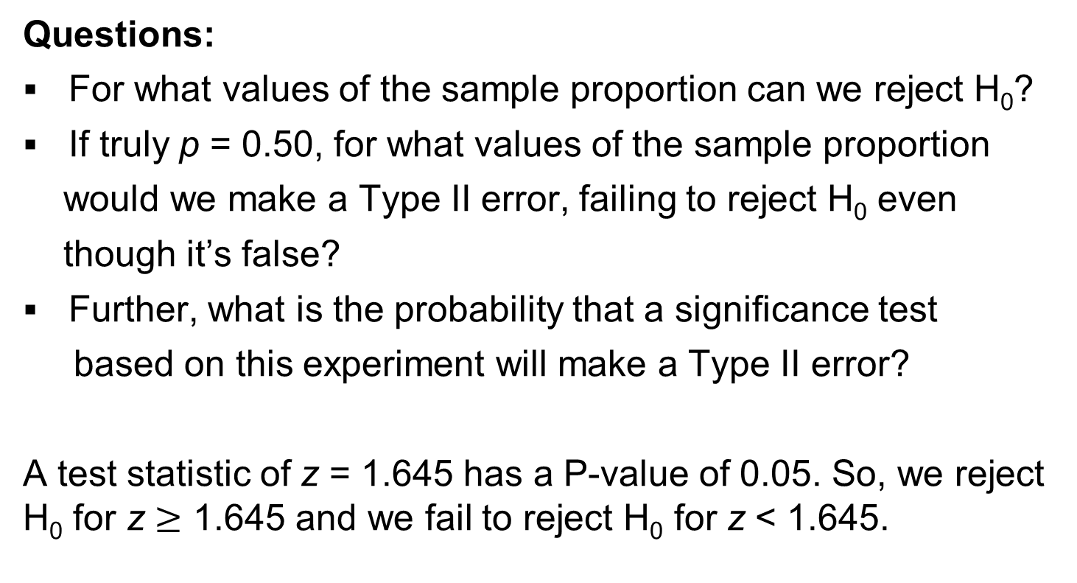
Example: Part of a Study Design
Notes:
83

Slide 84
Example: Part of a Study Design
Find the value of the sample proportion that would give us a z of 1.645:
  So, we reject H₀ when we get a sample proportion that is 0.405 or larger.
Notes:
84

Slide 85
Example: Part of a Study Design
Suppose that in reality astrologers can make the correct prediction 50% of the time (that is, p = 0.50).
In this case, (p = 0.50), we can now calculate the probability of a Type II error.
Notes:
85

Slide 86
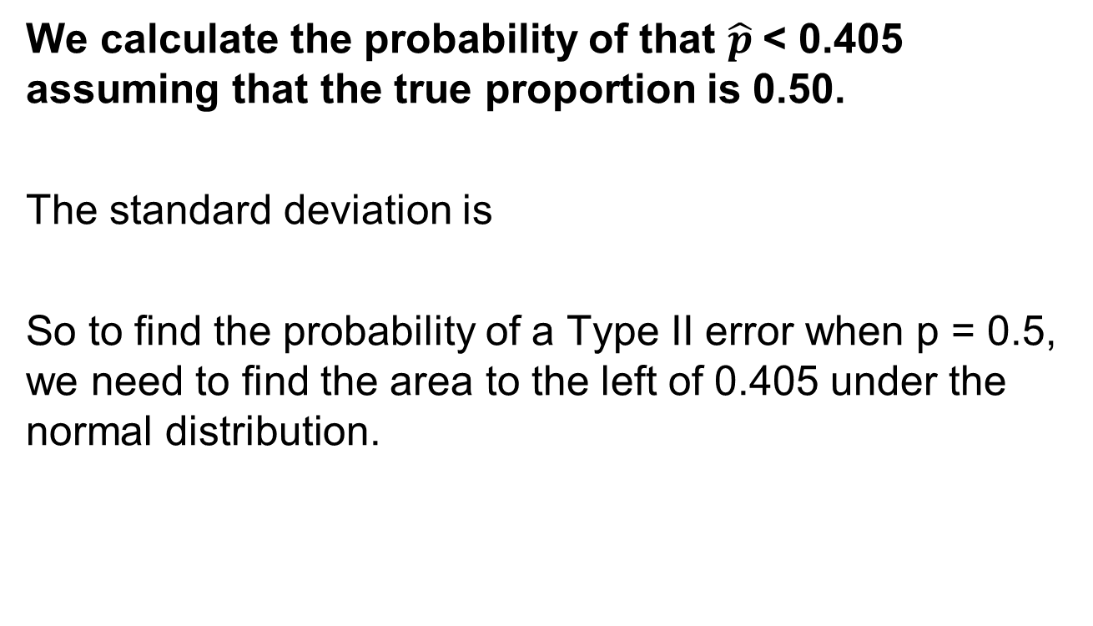
Example: Part of a Study Design
Notes:
86

Slide 87
Example: Part of a Study Design
The area to the left of 0.405 in the standard normal table is 0.02.
In Summary: The probability of making a Type II error and failing to reject H₀: p = 1/3 is only 0.02 in the case for which the true proportion is 0.50.
This is only a small chance of making a Type II error.
Notes:
87

Slide 88
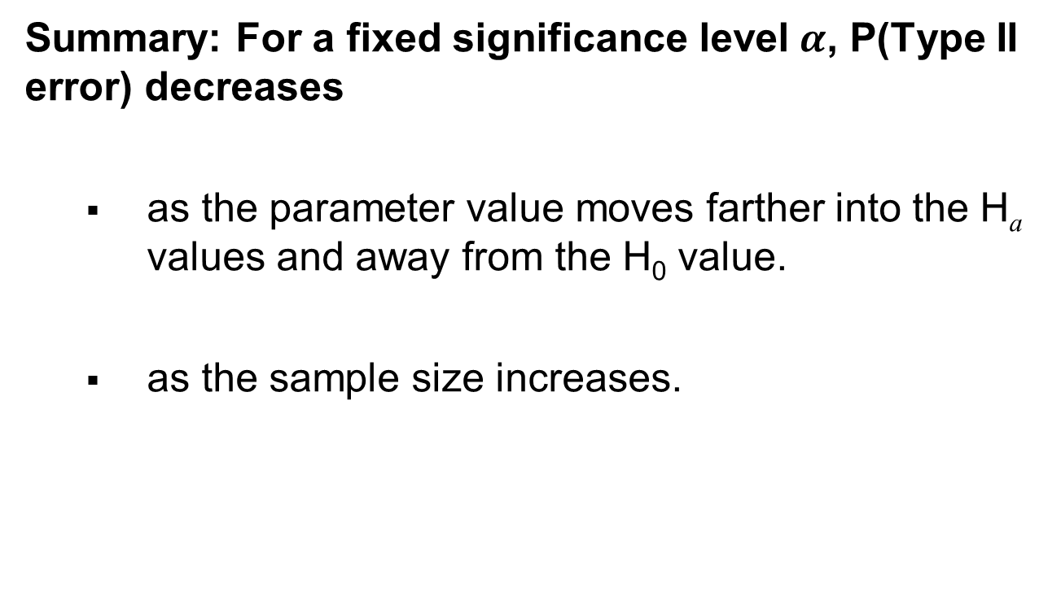
Type II Error
Notes:
88

Slide 89
The Power of a Test
When H₀ is false, you want the probability of rejecting it to be high. The probability of rejecting H₀ when it is false is called the power of the test.
Power = 1 – P(Type II error) for a particular value of the parameter from the range of alternative hypothesis values.
The higher the power, the better.
In practice, it is ideal for studies to have high power while using a relatively small significance level.
Notes:
89

Slide 90
The Power of a Test
In the example Part of a Study Design, the Power of the test when p = 0.50 is:
Power = 1 – P(Type II error) = 1 – 0.02 = 0.98.
Since, the higher the power the better, a test with power of 0.98 is quite good.
Notes:
90

